Slide 1

July 18th, 2024
Code Interfaces
RAVEN Workshop

Slide 2
Objectives
Learn about how RAVEN interacts with codes
Learn about existing Code Interfaces
Learn about the Generic Code interface
See how to create new Code Interfaces
Learn how to decide what interface to use for new codes

Slide 3

RAVEN and Codes
RAVEN’s primary purpose is to run your code
Perturb inputs
Collect outputs
Postprocess results
Statistics
Risk analysis
Optimization
Machine learning / AI
Outputs
Inputs

Slide 4
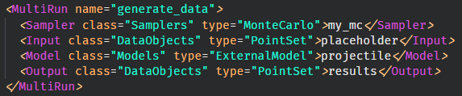
How RAVEN Runs Codes
RAVEN MultiRun Step acts just like a code user
Modify a text-based input file
Run the code on the command line
Collect results from the code run
Sampler
Input
Output
Model

Slide 5
RAVEN and Codes
Parallel Code Operation
On shared memory (workstation)
On distributed memory (HPC)
RAVEN acts like a legion of analysts
Set up the input
Run the simulation
Collect the output

Slide 6

Code Interfaces
How does RAVEN know how to run a Code?
Teach RAVEN how to talk to each Code
Special Python classes in RAVEN
Allow for customizing interactions for each code
How to read inputs
How to perturb inputs
How to generate a command
How to read in outputs
A generic interface also exists
Requires a “standard” code
Easy-to-parse text input
Simple CSV output

Slide 7

Existing Interfaces
“If I have seen further it is by standing on the shoulders of giants.”
– Isaac Newton

Slide 8
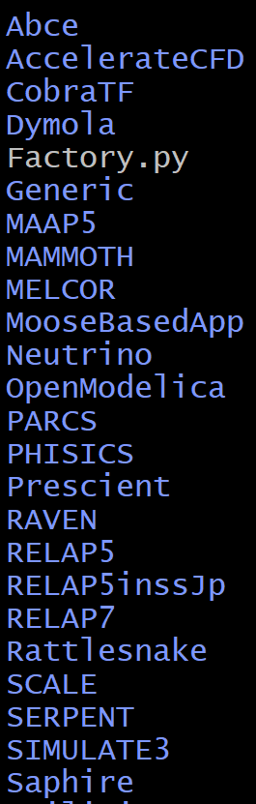
Existing Interfaces
RAVEN has many existing CodeInterfaces
Contributions from RAVEN team
Also from industry, university partners
Many have specialized methods for their Code
List of coupled codes is growing all the time
Contribute yours today!
raven/ravenframework/CodeInterfaceClasses/

Slide 9
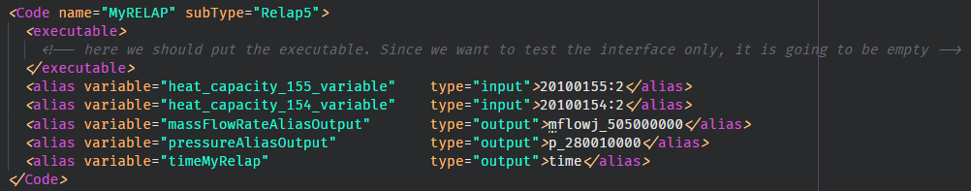
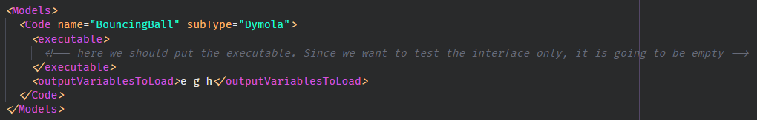
Using Existing Interfaces
Code objects are part of the Models block
Specific Codes will have different input features
Aliasing can really help for card-based inputs!

Slide 10
RAVENception
If RAVEN runs codes …
… and RAVEN is a code …
… can RAVEN run RAVEN?
Yes!
Two levels max, though
Used to parametrize or optimize parts of RAVEN input
Parameter tuning
Space exploration
Leader-follower optimization
Use with caution!
Gets complicated quickly.

Slide 11
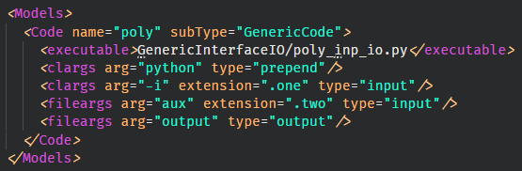
Generic Code Interface
For some codes, no special treatment necessary
Text-based input that can be parsed around “wildcards”
Already produces a standard “comma-separated value” (CSV) file
Specify “command line arguments” (clargs)
Specify “file arguments” (fileargs)
$> python GenericInterfaceIO/poly_inp_io.py –i filename.one

Slide 12
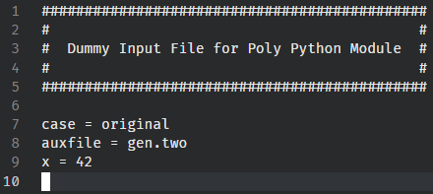
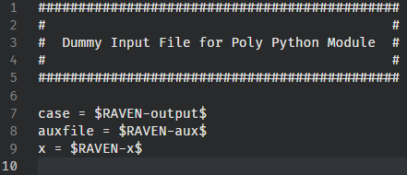
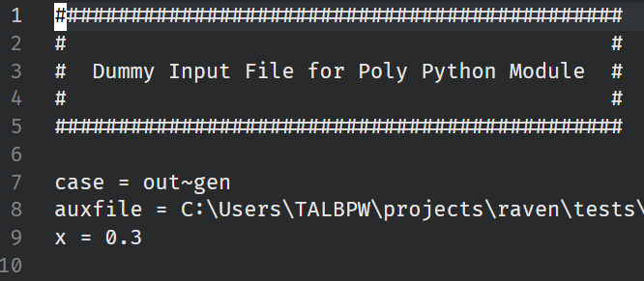
Generic Code Interface: Input Files
Original Input
Modified for RAVEN
Sampled by RAVEN

Slide 13

New Interfaces
“Don’t reinvent the wheel, just realign it.”
– Anthoney D’Angelo

Slide 14
Coupling a New Code
Write a New Code Interface
Based on Python OOP
Class inheritance
Extending definitions
Many methods available
Two Required
Highly Customizable
RAVEN team can help!
class newApplication(CodeInterfaceBase):
def generateCommand(self, input, exe, clargs, fargs)
Required
def createNewInput(self, inputs, oinputs, samplerType)
Required
def initialize(self,runInfo, oinputs)
Optional
def finalizeCodeOutput(self, command, output, workDir)
Optional
def checkForOutputFailure(self, output, workDir)
Optional
def getInputExtension(self)
Optional
def setInputExtension(self, exts)
Optional
def setRunOnShell(self, shell=True)
Optional

Slide 15
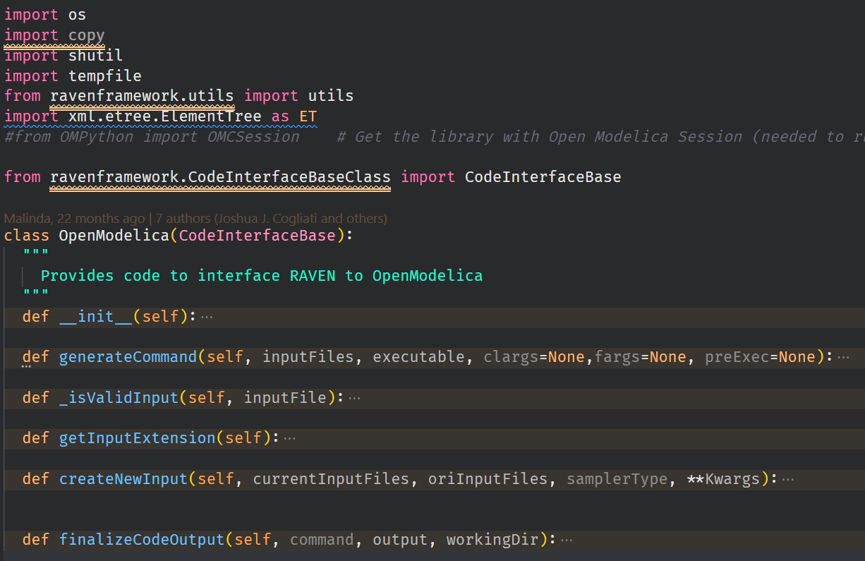
Creating a New Interface
raven/ravenframework/CodeInterfaceClasses/
Create a new file (or copy an existing one)
Inherit from CodeInterfaceBase
Implement two required methods
generateCommand
createNewInput
Add any additional optional methods
Add regression tests
Example: OpenModelica

Slide 16
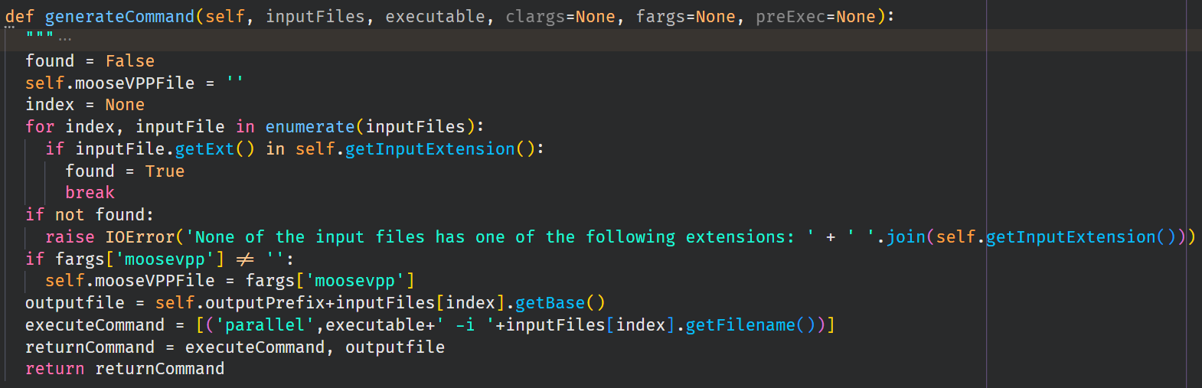
New Code Interface: generateCommand
Tells RAVEN how to run your code, and where to collect the output
Builds command line call
Tells RAVEN whether the code can be run in parallel (MPI)
Chooses how to name Code output so RAVEN can collect results
Example: MooseBasedApp

Slide 17
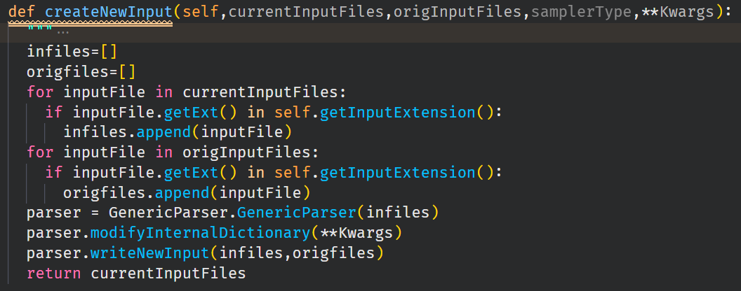
New Code Interface: createNewInput
Tells RAVEN how to generate a new input
Frequently makes use of a “parser” to help manage input
Read existing input
Make modifications based on RAVEN sample requests

Slide 18



New Code Interface: Optional Methods
Many more operations possible in interface
Set up general data or structure:
How to collect non-CSV results:
How to check for code failures:
How to identify input file format:
Setting input file format:
Modify command line operation:
def initialize(self,runInfo, oinputs)
def finalizeCodeOutput(self,command,output,workDir)
def checkForOutputFailure(self,output,workDir)
def getInputExtension(self)
def setInputExtension(self, exts)
def setRunOnShell(self, shell=True)

Slide 19
RAVEN runs Codes: Mechanics
raven_input.xml
workingDir/
What actually happens when RAVEN samples Codes?
Creates a folder for the MultiRun Step
Creates new folders under Step
One folder per sample
Numbered by the “job” run
See RAVEN screen output for job numbers
Individual code run outputs stored here
Collect results from individual run
Return results to the working directory
Sometimes going into sample directories can help
Debugging failed runs
raven_results.csv
MultiRunStepName/
templateInput.txt
1/
2/
3/
…
n/
moddedInput.txt
out~filename
output.csv

Slide 20
Code Interfaces: Summary Recap
RAVEN runs codes
Existing interfaces
Many existing codes
RAVEN runs RAVEN
Generic Interface
New Interfaces
Extend capability
Contribute to RAVEN (optional)

